Slide 1


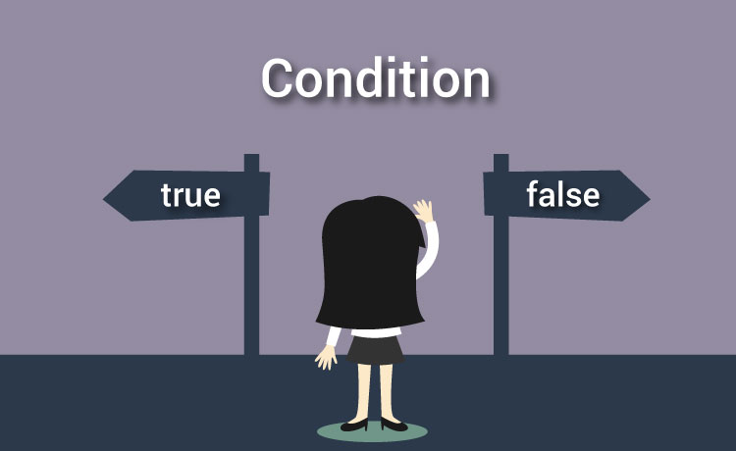

Simple Conditions
Relational operators and conditional statements
Основи на
програмирането
SoftUni Team
Technical Trainers
Software University
http://softuni.bg

Slide 2
Have a Question?
sli.do 123321

Slide 3

Content
Logical and relational operators
<, >, ==, !=, …
Conditional statements if and if/else
Scope of a variable
Debugging
5. Nested statements
6. More complex logical conditions
Logical "AND", "OR", "NEGATION" and priority

Slide 4

Relational operators

Slide 5
Comparing values
We can do the following in programming:
var a = 5;
var b = 10;
Console.WriteLine(a < b);
// True
Console.WriteLine(a > 0);
// True
Console.WriteLine(a > 100);
// False
Console.WriteLine(a < a);
// False
Console.WriteLine(a <= 5);
// True
Console.WriteLine(b == 2 * a);
// True

Slide 6
Operators
Оператор | Означение | Работи за
Equality | == | numbers, strings, dates
Inequality | !=
Greater than | > | numbers, dates, other comparable types
Greater than or equal | >=
Less than | <
Less than or equal | <=
Example:
var result = 5 != 6;
Console.WriteLine(result); // True

Slide 7
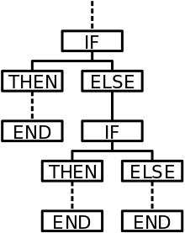
Simple conditions
Conditional statements

Slide 8
Simple conditions
In programming we check conditions and execute different code depending on the result of the check.
Example: we enter a grade and check if it is excellent (≥ 5.50)
var grade = double.Parse(Console.ReadLine());
if (grade >= 5.50)
{
Console.WriteLine("Excellent!");
}
Test your solution: https://judge.softuni.bg/Contests/Compete/Index/859#0

Slide 9
If/Else conditional statement
We enter a grade and check if it is excellent or not:
var grade = double.Parse(Console.ReadLine());
if (grade >= 5.50)
{
Console.WriteLine("Excellent!");
}
else
{
Console.WriteLine("Not excellent.");
}
Test your solution: https://judge.softuni.bg/Contests/Compete/Index/859#1

Slide 10
Even or odd – example
Write a program which checks if a number is even or odd:
If it is even print "even"
If it is odd print "odd"
44
even
3
odd
Test your solution: https://judge.softuni.bg/Contests/Compete/Index/859#2

Slide 11
Even or odd – solution
var num = int.Parse(Cosnole.ReadLine());
if (num % 2 == 0)
{
Console.WriteLine("even");
}
else
{
Console.WriteLine("odd");
}
Test your solution: https://judge.softuni.bg/Contests/Compete/Index/859#2

Slide 12

Scope of a variable

Slide 13
Scope of a variable
There is a certain scope in which you can use a variable after it is declared:
var currentDay = "31.12.2016";
double myMoney = 0;
if (currentDay == "31.12.2016")
{
var salary = double.Parse(Console.ReadLine());
myMoney = myMoney + salary;
}
Console.WriteLine(myMoney);
Console.WriteLine(salary);
// Error!

Slide 14
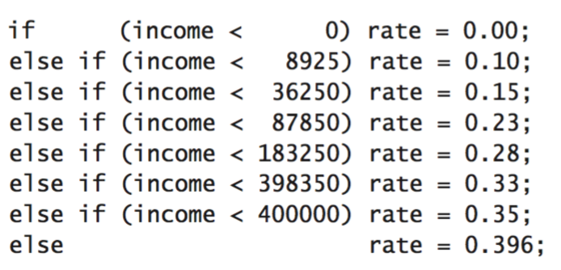
Series of checks

Slide 15
Series of checks
The branching statements if/else-if/else… can be written one after another.
Example: Check if the entered number is bigger than 4 or 6.
var num = 7;
if (num > 4)
{ Console.WriteLine(num + " is bigger than 4"); }
if (num > 6)
{ Console.WriteLine(num " is bigger than 6"); }
Output: 7 is bigger than 4
7 is bigger than 6

Slide 16
Series of checks(2)
Check if an entered number is bigger than 4 or 6?
var num = 7
if (num > 6)
{
Console.WriteLine(num + " is bigger than 6");
}
else if (num > 4)
{
Console.WriteLine(num " is bigger than 4");
}

Slide 17
Number 0…9 to text – example
Translate an entered number in English (from 0 to 10)
If a number is bigger than 9 you should write "number too big".
2
two
7
seven
var num = int.Parse(Console.ReadLine());
if (num == 1)
{ Console.WriteLine("one"); }
else if (num == 2)
{ Console.WriteLine("two"); }
else if (num == 3)
{ Console.WriteLine("three"); }
// TODO Write more logic here…
Test your solution: https://judge.softuni.bg/Contests/Compete/Index/859#3

Slide 18

Debugging

Slide 19
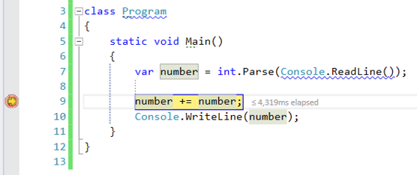
Debugging
Debugging lets you observe the execution of your program step by step and keep track of all local variables.
This helps us locate and fix mistakes in the code (bugs)

Slide 20
Debugging in Visual Studio
A press of [F10] will start the program in debug mode.
We can step to the next line of code with pressing again [F10]
We can create breakpoints with a press of [F9]
We can jump to a breakpoint with the button [F5]

Slide 21



Nested conditions
Nested if statements

Slide 22
Nested statements
If-else statements can be nested:
We get to the nested statement only when condition1 is true
Nested if statement
if (condition1) {
Console.WriteLine("condition1 valid");
if (condition2)
Console.WriteLine("condition2 valid");
else
Console.WriteLine("condition2 not valid");
}

Slide 23
Small shop – example
Write a program which:
Reads the following user input:
Product name
Town
Quantity
Calculates the products price using the table below:
град / продукт | coffee | water | beer | sweets | peanuts
Sofia | 0.50 | 0.80 | 1.20 | 1.45 | 1.60
Plovdiv | 0.40 | 0.70 | 1.15 | 1.30 | 1.50
Varna | 0.45 | 0.70 | 1.10 | 1.35 | 1.55

Slide 24
Small shop – example (2)
Example input and output:
coffee
Varna
2
0.9
peanuts
Plovdiv
1
1.5
beer
Sofia
6
7.2

Slide 25
Small shop – solution
var productName = Console.ReadLine();
var town = Console.ReadLine();
var quantity = Console.ReadLine();
if (town == "Sofia")
{
if (productName == "coffee") quanity * 0.50;
// TODO: finish the checks for all the products…
}
else if (town == "Plovdiv")
else if (town == "Varna")
// TODO: check other towns …
Test your solution: https://judge.softuni.bg/Contests/Compete/Index/859#4

Slide 26

More complex logical conditions
&&, || , !
Boolean operators

Slide 27
Boolean operators
Operators that include or exclude conditions
They return a Boolean result (true or false)
"&&" - AND
"||" - OR
"!" - NEGATION
true
true
false
true
false
The two conditions
must be true
Only the one of the
two conditions
must be true
Negation of a condition

Slide 28
Logical "AND"
All of the conditions must be true
Example: check if a number is:
Bigger than 5 AND smaller than 10
AND even
&&
var a = int.Parse(Console.ReadLine());
if (a > 5 && x < 10 && a % 2 == 0) …

Slide 29
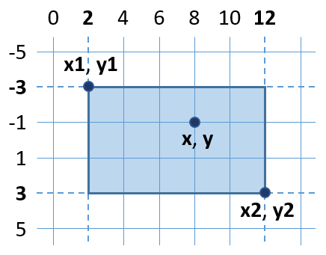
Point in rectangle – example
Write a program which:
Checks if a point is inside a rectangle
To be inside a rectangle a point must be:
To the right of its left side
To the left of its right side
Down on its top side
Up on its bottom side

Slide 30
Point in rectangle – solution
double x = double.Parse(Console.ReadLine());
double x1 = double.Parse(Console.ReadLine());
// TODO: Read the coordinates of the points …
if (x >= x1 && x <= x2 && y >= y1 && y <= y2)
Cosnole.WriteLine("Inside");
else
Console.WriteLine("Outside");
Test your solution: https://judge.softuni.bg/Contests/Compete/Index/859#5

Slide 31
Logical "OR"
Only one of the conditions must be true
Example: check if the entered word is:
"Example" or "Demo"
||
string word = Console.ReadLine();
if (word == "Example" || word == "Demo") …

Slide 32
Fruit or vegetable – example
Write a program which:
Checks if the user input is a fruit or a vegetable:
Fruits: banana, apple, kiwi, cherry, lemon, grapes
Vegetables: tomato, cucumber, pepper, carrot
You should print: "vegetable","fruit" or "unknown"
Example output:
lemon
fruit
carrot
vegetable
java
unknown

Slide 33
Fruit or vegetable – solution
string food = Console.ReadLine();
if (food == "banana" || food == "apple" || food == "kiwi" ||
food == "cherry" || food == "lemon" || food == "grapes")
{
Console.Writeline("fruit");
}
else if (food == "tomato" || food == "cucumber" || food == "pepper" || food == "carrot")
{
Console.Writeline("vegetable");
}
else {
Console.Writeline("unknown");
}
Test your solution: https://judge.softuni.bg/Contests/Compete/Index/859#6

Slide 34
Priority of conditions
We can change the priority using ()
Example:
Check if a number is in the range [100… 200] or is equal to 0
int a = 5;
if ((a >= 100 && a <= 200) || a == 0) {
Console.WriteLine("In range");
}

Slide 35
Negation
Returns true only if the conditions result is false
Returns false if the conditions result is true
Example:
Check if a number is greater than 10 and even:
!
bool isValid = (number > 10) && (number % 2 == 0);
if (!isValid)
Console.WriteLine("Invalid");

Slide 36
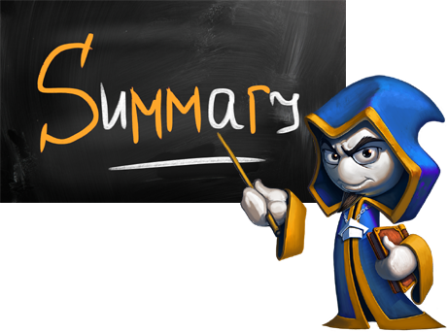

Summary
Conditional statements if and if-else:
if (condition)
{
commands;
}
else if (condition)
{
commands;
}
else
{
commands;
}
if (check)
single command;
else if (condition2)
single command;
else if (condition3)
single command;
else if (condition4)
single command;
else if (condition5)
single command;
else
single command;

Slide 37
Summary (2)
Nested statements:
More complex logical conditions &&, ||, ! и ()
if (condition1)
{
if (condition2) …
else …
}
if ((x == left || x == right) && y >= top && y <= bottom)
{ Console.WriteLine("Point on the left or right side."); }

Slide 38







Simple conditions
https://softuni.bg/courses/programming-basics/

Slide 39
License
This course (slides, examples, demos, videos, homework, etc.) is licensed under the "Creative Commons Attribution-NonCommercial-ShareAlike 4.0 International" license

Slide 40





Trainings @ Software University (SoftUni)
Software University – High-Quality Education, Profession and Job for Software Developers
softuni.bg
Software University Foundation
http://softuni.foundation/
Software University @ Facebook
facebook.com/SoftwareUniversity
Software University Forums
forum.softuni.bg

